Slide 1
Claims Process Digitization
By Gopalakrishnan Kumar, MTech IIT-Bombay,
Freelance Data Science Consultant
LinkedIn: Profile Link : https://www.linkedin.com/in/gopalakrishnankumar-a73301110/
Github:https://github.com/Gopal21236/
Kaggle URL- https://www.kaggle.com/gopalkk2

Slide 2
Google Colab URL
https://colab.research.google.com/drive/1xVdcCMcnqkYaiYZ9dtc3slD-2xGiVpYj?usp=sharing

Slide 3
Executive Summary
Insurance claims processing is traditionally manual, time-consuming, and prone to delays. This project digitizes the end-to-end claims lifecycle by simulating structured workflows, automating approval logic, and measuring operational performance using analytics and visualization techniques.
The objective is to improve turnaround time (TAT), operational efficiency, fraud detection, and customer satisfaction through data-driven process optimization.

Slide 4
Business Problem
Insurance companies face several operational challenges:
Long claim settlement timelines
Manual verification delays
High operational costs
Inconsistent fraud detection
Poor SLA monitoring
Without digitization, claims processing becomes fragmented and inefficient, impacting both profitability and customer trust.

Slide 5
Project Objectives
This project aims to:
Simulate a digitized claims workflow
Automate claim approval and fraud screening
Track processing time across stages
Monitor approval vs rejection rates
Identify bottlenecks using analytics

Slide 6
Digitized Workflow Design
Stage 1 – Digital Submission
Claims submitted via:
Mobile App
Web Portal
Agent
Automation captures structured claim data.

Slide 7
Digitized Workflow Design
Stage 2 – Automated Verification
Policy validation
KYC check
Fraud screening
Initial document verification

Slide 8
Digitized Workflow Design
Stage 3 – Assessment
Medical / Damage evaluation
Amount validation
Risk scoring

Slide 9
Key Performance Indicators (KPIs)
Approval Rate (%)
Rejection Rate (%)
Average Processing Time (TAT)
Total Claim Amount Processed
Fraud Detection Ratio
These KPIs help evaluate operational efficiency and risk exposure.

Slide 10
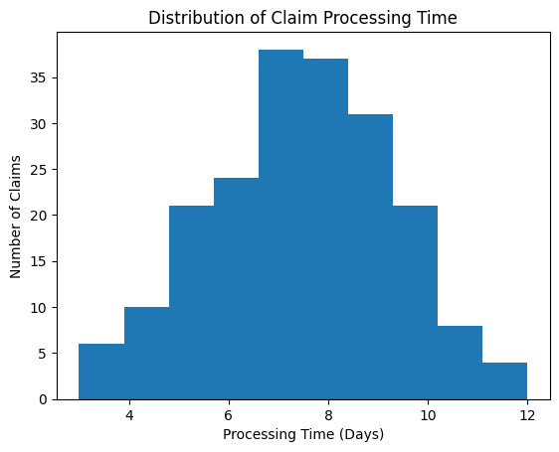
Data Visualization

Slide 11
Visualization & Analytics
7.1 Histogram – Processing Time Distribution
Purpose:
Shows distribution of total claim processing time.
Insight:
Majority of claims cluster within standard processing window
Long-tail delays indicate bottlenecks
Helps define SLA thresholds
Business Value:
Enables turnaround optimization.

Slide 12
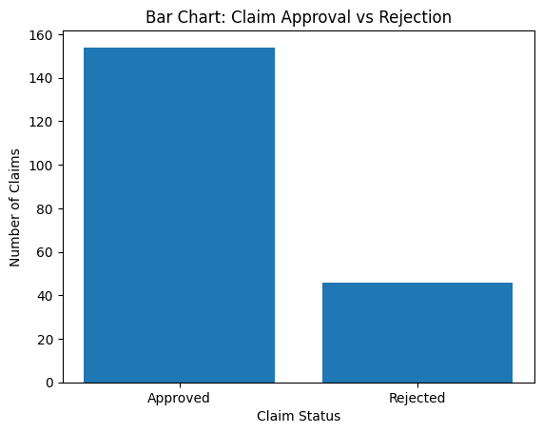
Data Visualization

Slide 13
Visualization & Analytics
7.2 Bar Chart – Claim Approval vs Rejection
Purpose:
Displays volume of approved vs rejected claims.
Insight:
Measures underwriting strictness
Highlights fraud impact
Business Value:
Supports portfolio risk monitoring.

Slide 14
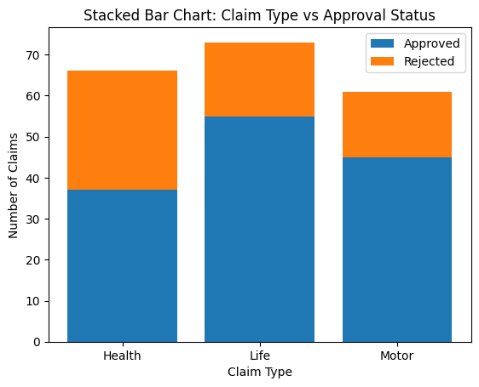
Data Visualization

Slide 15
Visualization & Analytics
7.3 Stacked Bar Chart – Claim Type vs Status
Purpose:
Breaks down approval/rejection by claim type.
Insight:
Certain claim types may show higher rejection
Helps identify risk-heavy segments
Business Value:
Improves underwriting refinement by product line.

Slide 16
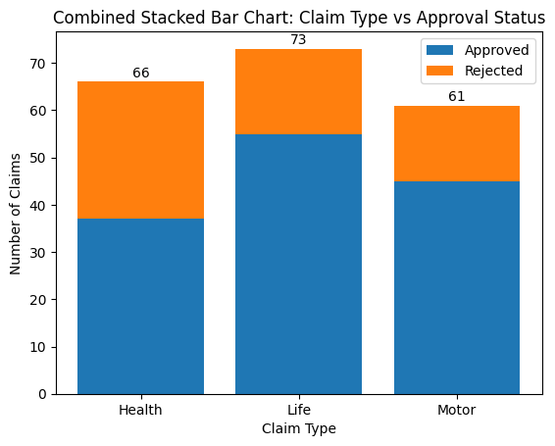
Data Visualization

Slide 17
Visualization & Analytics
7.4 Combined Stacked Bar Chart – Executive View
Purpose:
Combines:
Total claims per type
Approval composition
Annotated totals
Insight:
Provides single-view decision dashboard.
Business Value:
Ideal for management-level reporting.

Slide 18
Key Insights
Digitization reduces manual bottlenecks
Automated decision rules improve consistency
Fraud screening significantly impacts rejection rate
Health claims often show longer TAT due to medical validation
Real-time monitoring enhances SLA adherence

Slide 19
Business Impact
This digitized framework enables:
Faster claim settlement
Reduced operational costs
Improved fraud detection
Enhanced customer experience
Better regulatory compliance

Slide 20
Limitations
Simulated dataset
No real-time API integration
No ML-based predictive risk scoring

Slide 21
Future Enhancements
ML-based fraud prediction
Real-time claims dashboard
OCR document automation
AI-powered medical assessment
Predictive TAT optimization

Slide 22
Conclusion
Claims Process Digitization transforms traditional manual workflows into structured, analytics-driven systems. By combining automation, KPI tracking, and visualization techniques, insurers can significantly improve efficiency, reduce fraud exposure, and enhance customer satisfaction.
This project demonstrates how data analytics enables measurable improvements in operational performance and risk management.

